Slide 1
OUTLINE
The importance
Three theories of elastic failure
Maximum principal stress theory (Rankine’s theory)
Maximum shear stress theory (Coulomb, Tresca and Guest’s theory)
Distortion energy theory (Huber von Mises and Henky’s theory)
Examples

Slide 2
The Importance
Theories of elastic failure provide a relationship between the strength of the machine component subjected to complex state of stresses with the mechanical properties obtained in tension test.
With the help of these theories, the data obtained in the tension test can be used to determine the dimensions of the component, irrespective of the nature of stresses induced in the component due to complex loads.

Slide 3
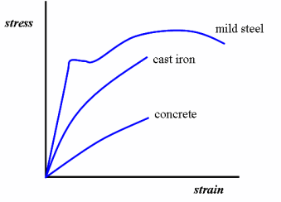
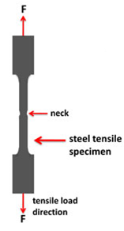
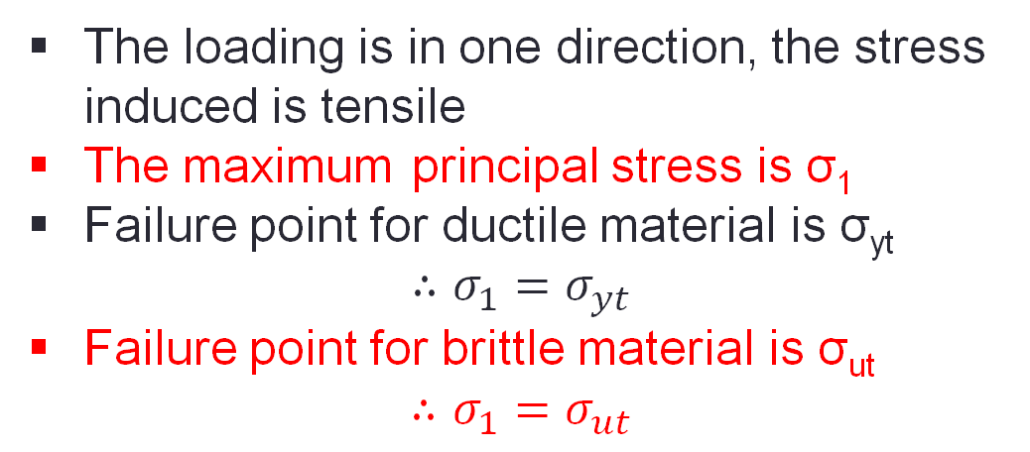
Simple Tensile Test
The loading is in one direction, the stress induced is tensile
The maximum principal stress is σ₁
Failure point for ductile material is σ_{yt}
$$∴σ_{1}=σ_{yt}$$
Failure point for brittle material is σ_{ut}
$$∴σ_{1}=σ_{ut}$$

Slide 4
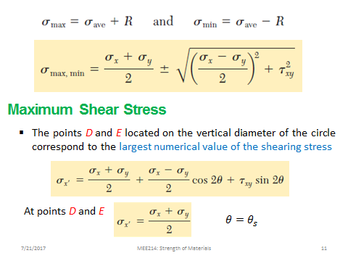
Principle stress concept

Slide 5
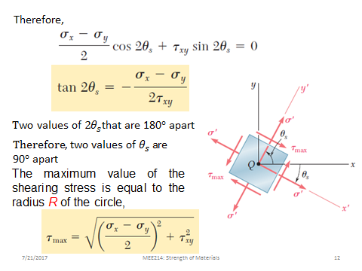

Slide 6
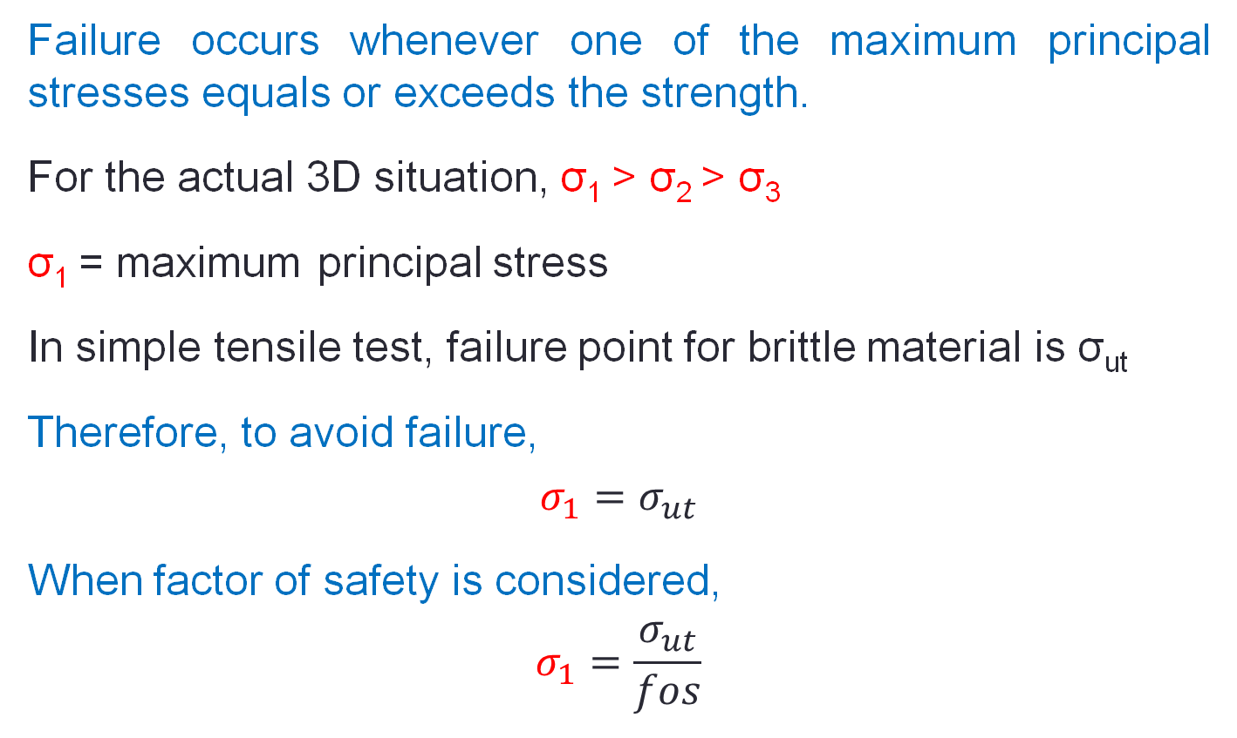
Maximum principal stress theory (Rankine’s theory)
Failure occurs whenever one of the maximum principal stresses equals or exceeds the strength.
For the actual 3D situation, σ₁ > σ₂ > σ₃
σ₁ = maximum principal stress
In simple tensile test, failure point for brittle material is σ_{ut}
Therefore, to avoid failure,
$$σ_{1}=σ_{ut}$$
When factor of safety is considered,
$$σ_{1}=\frac{σ_{ut}}{fos}$$
It is suitable for brittle material

Slide 7
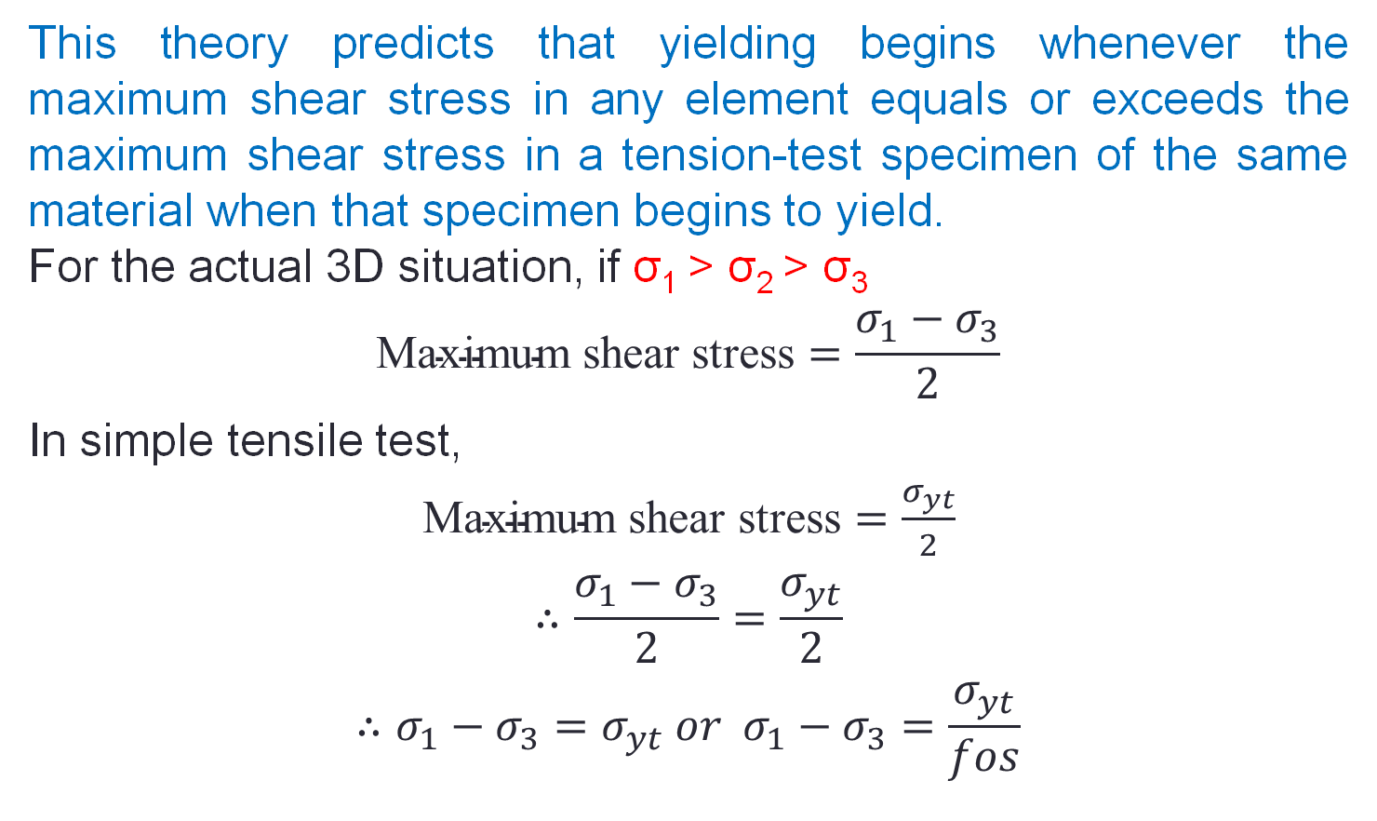
Maximum shear stress theory (Coulomb, Tresca and Guest’s theory)
This theory predicts that yielding begins whenever the maximum shear stress in any element equals or exceeds the maximum shear stress in a tension-test specimen of the same material when that specimen begins to yield.
For the actual 3D situation, if σ₁ > σ₂ > σ₃
$$\text{Maximum} \text{shear} \text{stress}=\frac{σ_{1}−σ_{3}}{2}$$
In simple tensile test,
$\text{Maximum} \text{shear} \text{stress}=\frac{σ_{yt}}{2}$
$$∴\frac{σ_{1}−σ_{3}}{2}=\frac{σ_{yt}}{2}$$
$$∴σ_{1}−σ_{3}=σ_{yt} or{ σ}_{1}−σ_{3}=\frac{σ_{yt}}{fos}$$

Slide 8
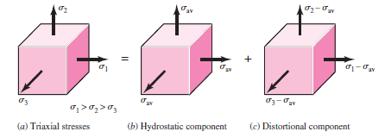

Distortion energy theory (Huber von Mises and Henky’s theory)
This theory predicts that yielding occurs when the distortion strain energy per unit volume reaches or exceeds the distortion strain energy per unit volume for yield in simple tension or compression of the same material.
Element with triaxial stresses will undergo both volume change and angular distortion.
Strain energy/unit volume,

Slide 9




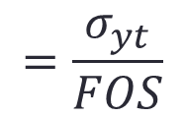
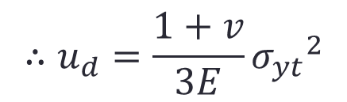

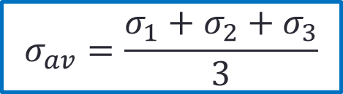
Strain energy for producing volume change,
$$σ_{av}=\frac{σ_{1}+σ_{2}+σ_{3}}{3}$$
Distortion energy obtained by,
$$σ_{1}=σ_{yt} and σ_{2}=σ_{3}=0$$
For the simple tensile test,
$$∴u_{d}=\frac{1+v}{3E}{σ_{yt}}^{2}$$
$$=\frac{σ_{yt}}{FOS}$$

Slide 13
3.A shaft is loaded by a torque of 5 KN-m. The material has a yield point of
350 MPa. Find the required diameter using
(a) Maximum shear stress theory
(b) Maximum distortion energy theory
Take a factor of safety of 2.5.`

Slide 14
A cantilever rod is loaded as shown in the figure- 3.1.6.3. If the tensile yield strength of the material is 300 MPa determine the rod diameter using (a) Maximum principal stress theory (b) Maximum shear stress theory (c) Maximum distortion energy theory.

Slide 18
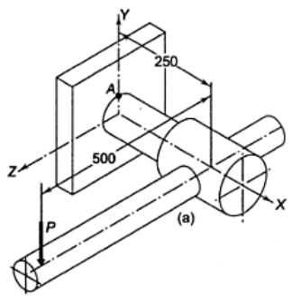
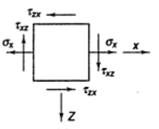
Example 1
The shaft of an overhang crank subjected to a force P of 1 kN is shown in Figure. The shaft is made of plain carbon steel 45C8 and the tensile strength is 380 MPa. The factor of safety is 2. Determine the diameter of the shaft using maximum shear stress theory.
d=31.06 mm

Slide 19
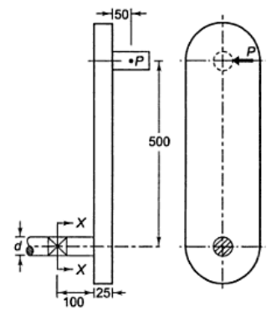
Example 2
The dimensions of an overhang crank are given in Figure. The force P acting at the crankpin is 1 kN. The crank is made of steel 30C8 (σ_{yt}= 400 N/mm²) and the factor of safety is 2. Using maximum shear stress theory of failure, determine the diameter d at the section -XX
d=30 mm

Slide 20
Example 3
The bolt is subjected to a direct tensile load of 25 kN and a shear load of 15 kN. Considering various theories of failure, determine the suitable size of the bolt if the yield stress in tension is 250 N/mm². Take factor of safety as 2.

